Slide 1
Belbin roles etc.

Slide 2
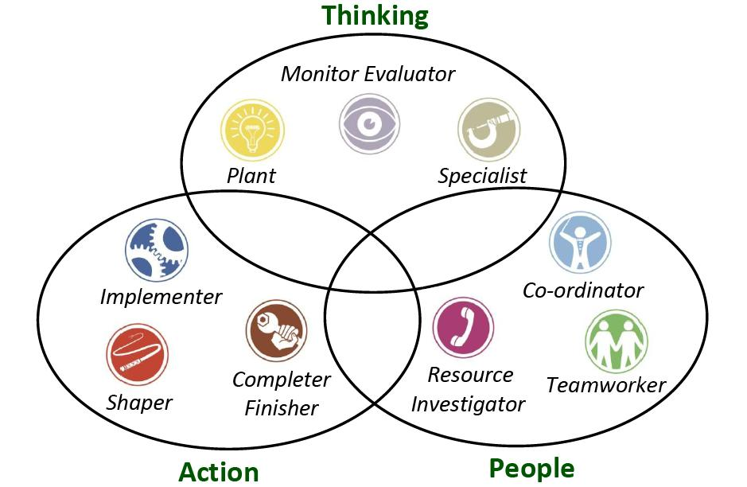

Slide 3


Slide 4


